Slide 1
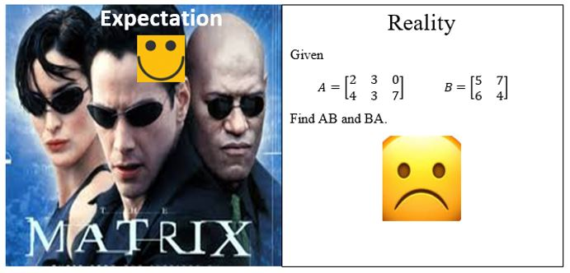

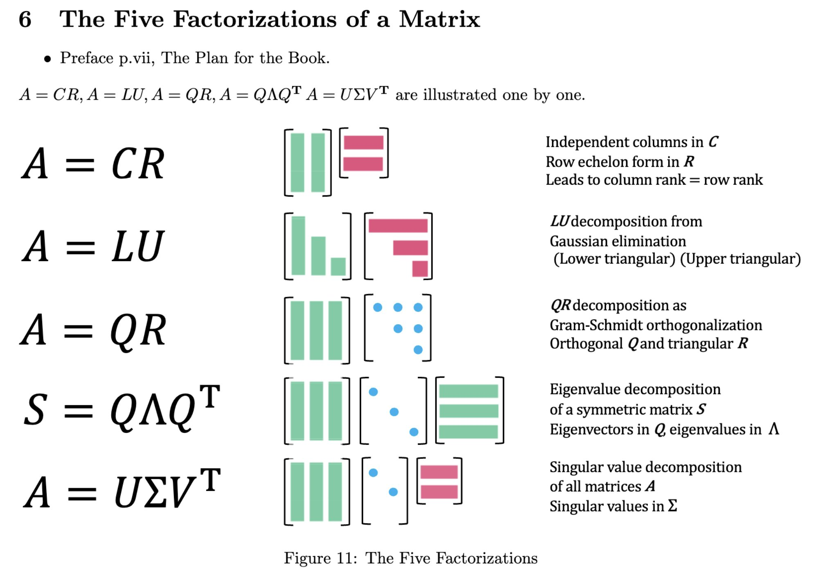



Slide 5
What about the converse ???

Slide 8
Orthogonal Basis

Slide 9
Orthogonal and Orthonormal Basis

Slide 10
Orthogonal and Orthonormal Basis
Construct the orthonormal basis

Slide 11
Orthogonal and Orthonormal Basis

Slide 12
Orthogonal and Orthonormal Basis

Slide 13
Orthogonal matrices

Slide 14
Orthonormal
set

Slide 15
Orthonormal
Set and Orthogonal matrix

Slide 16
Orthogonal Matrix

Slide 17
Orthogonal Matrix

Slide 18
Orthogonal Matrix

Slide 19
Orthogonal Matrix
Properties

Slide 20
Orthogonal Matrix
Properties

Slide 21
Orthogonal Matrix
Properties

Slide 22
Orthogonal Matrix
Properties

Slide 23
Four Fundamental Subspaces

Slide 24
Four Fundamental Subspaces

Slide 25
Four Fundamental Subspaces

Slide 26
Four Fundamental Subspaces.
Example

Slide 27
Four Fundamental Subspaces
Example

Slide 28
Four Fundamental Subspaces
Example

Slide 29
Orthogonal Projection

Slide 30
Orthogonal Projection

Slide 31
Orthogonal Projection

Slide 32
Construction of orthogonal basis
(brute force)

Slide 33
Construction of orthogonal basis
(brute force)

Slide 34
Construction of orthogonal basis
(brute force)

Slide 35
Orthogonal decomposition Theorem

Slide 36
Orthogonal decomposition Theorem

Slide 37
Construction of orthogonal basis
(Two vectors)

Slide 38
Construction of orthogonal basis
(Last slide)
The Gram-Schmidt Process
Generalization to more than two vectors

Slide 39
Construction of orthogonal basis
The Gram-Schmidt Process
Generalization to more than two vectors

Slide 40
Construction of orthogonal basis
(Last slide)
The Gram-Schmidt Process
Generalization to more than two vectors

Slide 41
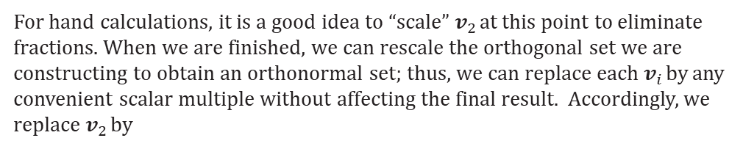
Construction of orthogonal basis
(Last slide)
The Gram-Schmidt Process
Generalization to more than two vectors
For hand calculations, it is a good idea to “scale” $v_{2}$ at this point to eliminate fractions. When we are finished, we can rescale the orthogonal set we are constructing to obtain an orthonormal set; thus, we can replace each $v_{i}$ by any convenient scalar multiple without affecting the final result. Accordingly, we replace $v_{2}$ by

Slide 42
Construction of orthogonal basis
(Last slide)
The Gram-Schmidt Process
Generalization to more than two vectors

Slide 43
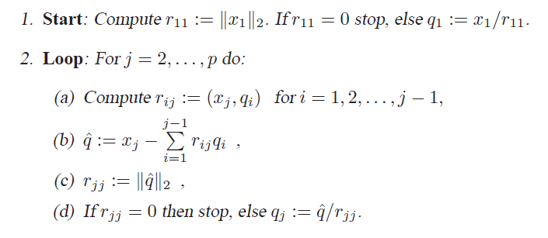
Construction of orthogonal basis
The Gram-Schmidt Process
Generalization to more than two vectors

Slide 44
The QR factorization

Slide 45
The QR factorization

Slide 46
The QR factorization

Slide 47
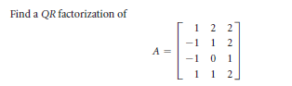
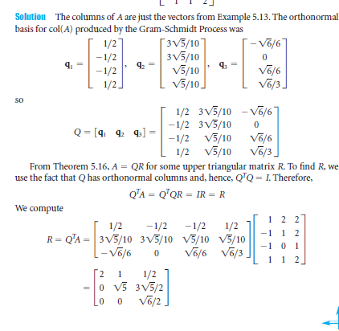
The QR factorization

Slide 48
The QR factorization
Detecting eigenvalue

Slide 49
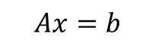
$$Ax=b$$
LU Decomposition

Slide 50
LU Decomposition

Slide 51

Code: Forward and Backward Substitution
%MATLAB program: forward-substitution for a lower triangular linear system
function x=forwardSubstitution_1a(L,b,n)
% Solving a lower triangular system by forward-substitution
% Input matrix L is an n by n lower triangular matrix
% Input vector b is n by 1
% Input scalar n specifies the dimensions of the arrays
% Output vector x is the solution to the linear system
% L x = b
% K. Ming Leung, 01/25/03
x=zeros(n,1);
for j=1:n
if (L(j,j)==0) error('Matrix is singular!'); end;
x(j)=b(j)/L(j,j);
b(j+1:n)=b(j+1:n)-L(j+1:n,j)*x(j);
end
%%%%%%%%%%%%%%%%%%%%%%%%%%%%%%%%%%%%%%%%%%%
%%% L=[1 0 0; 4 1 0; 4 0.5 1]; b=[3 6 10]';
%%% x=forwardSubstitution_1a(U,b,n)

Slide 52
Code: Forward and Backward Substitution
function x=backSubstitution_1a(U,b,n)
% Solving an upper triangular system by back-substitution
% Input matrix U is an n by n upper triangular matrix
% Input vector b is n by 1
% Input scalar n specifies the dimensions of the arrays
% Output vector x is the solution to the linear system
% U x = b
% K. Ming Leung, 01/26/03
x=zeros(n,1);
for j=n:-1:1
if (U(j,j)==0) error('Matrix is singular!'); end;
x(j)=b(j)/U(j,j);
b(1:j-1)=b(1:j-1)-U(1:j-1,j)*x(j);
end

Slide 53
LU decomposition and solving linear equations
function [L,A]=LU_factor_using_Gaussian_1a(A,n)
% LU factorization of an n by n matrix A
% using Gauss elimination without pivoting
% LU_factor.m
% A is factored as A = L*U
% Output:
% L is lower triangular with the main diagonal part = 1s.
% U is upper triangular and is stored in the original mtx A
% and must be zeroed out to get U
% K. Ming Leung, 01/26/03
%A=[1 2 2 ; 4 4 2; 4 6 4]; n=3;
L=eye(n);
for k=1:n
if (A(k,k) == 0)
Error('Pivoting is needed!'); end
L(k+1:n,k)=A(k+1:n,k)/A(k,k);
for j=k+1:n
A(j,:)=A(j,:)-L(j,k)*A(k,:);
end
end
%%% [L U]=lu(A);
clear all
%A=[1 1 1; 3 1 -3; 1 -2 -5];
A=[2 4 -2; 4 9 -3; -2 -3 7];
b=[2 8 10]';
[m n]=size(A);
%%%%%%%%% Medthod 1 from the following code%
[L1 U1]=LU_factor_using_Gaussian_1a(A,n);
Y2=forwardSubstitution_1a(L1,b,n);
x2=backSubstitution_1a(U1,Y2,n);

Slide 54
LU decomposition and solving linear equations
(Baked from Matlab function)
clear all
%A=[1 1 1; 3 1 -3; 1 -2 -5];
A=[2 4 -2; 4 9 -3; -2 -3 7];
b=[2 8 10]';
[m n]=size(A);
%%%%%% using Matlab function %%%%%%
[L U P]=lu(A);
%L(2,2)=10^-1;
%L(3,3)=10^-1;
%%%Method 1 for finding solution%%%
Y = L\(P*b);
x = U\Y;
%%%%%%%%%%%%%%%%%%%%%%
%%% Method 2 for finding solution %%%
Y1=forwardSubstitution_1a(L,P*b,n);
%%% [L,~]=LU_factor_using_Gaussian_1a(A,n)
x1=backSubstitution_1a(U,Y1,n);

Slide 55
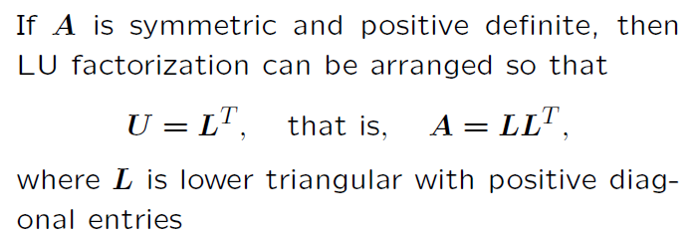
Symmetric Positive definite matrix : Cholesky Factorization

Slide 56
Symmetric Positive definite matrix : Cholesky Factorization

Slide 57
Symmetric Positive definite matrix : Cholesky Factorization

Slide 58
Symmetric Positive definite matrix : Cholesky Factorization

Slide 59
Symmetric Positive Definite matrix : Cholesky factorization

Slide 60
Symmetric Positive Definite matrix : Cholesky factorization

Slide 61
QR factorization

Slide 62
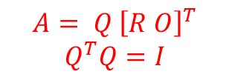
QR factorization
$$A= Q {\left[R O\right]}^{T}$$
$$Q^{T}Q=I$$

Slide 63
QR factorization
$$A= Q {\left[R O\right]}^{T}$$
$$Q^{T}Q=I$$
because orthogonal transformation preserves Euclidean norm

Slide 64
QR factorization
clear all
%% Solve Ax=b (overdtermined system)
A=[1 1 1 1 1; -1 -0.5 0 0.5 1.0; 1.0 0.25 0.0 0.25 1];
A=A';
b=[ 1 0.5 0 0.5 2];
b=b';
[q r]=qr(A);
x=q'*b./r;

Slide 65
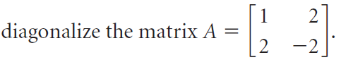
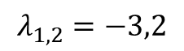
Orthogonal Diagonalization of Symmetric matrices
$$λ_{1,2}=−3,2$$
A=[ 1 2 ; 2 -2];
[Q D ]=eig(A);
Q =
-0.4472 -0.8944
0.8944 -0.4472
P(:,1)'*P(:,2)=0
If Q is orthogonal matrix, you do not need the inverse

Slide 66
Orthogonal Diagonalization of Symmetric matrices

Slide 67
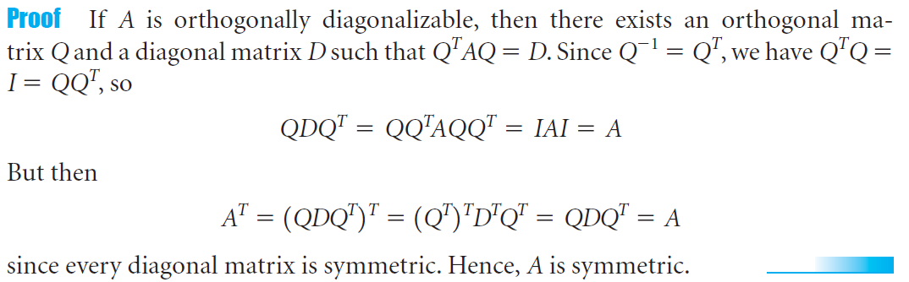
Orthogonal Diagonalization of Symmetric matrices

Slide 68
Orthogonal Diagonalization of Symmetric matrices
What about the eigenvalues of symmetric matrix?

Slide 69
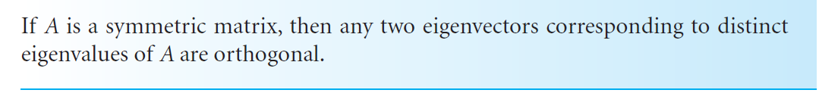
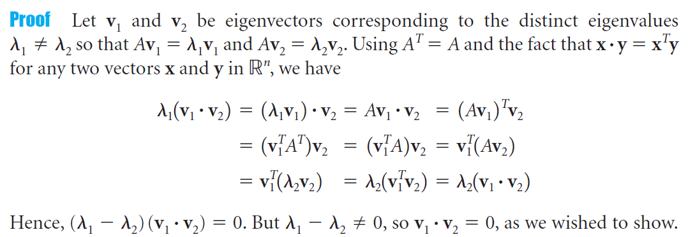
Orthogonal Diagonalization of Symmetric matrices

Slide 70
Orthogonal Diagonalization of Symmetric matrices

Slide 71
Orthogonal Diagonalization of Symmetric matrices

Slide 72
Orthogonal Diagonalization of Symmetric matrices

Slide 73
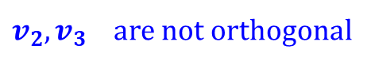
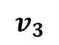
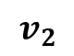
Orthogonally Diagonalize
$$v_{2}$$
$$v_{3}$$
$v_{2},v_{3}$ are not orthogonal

Slide 74
Spectral Decomposition
This is called the spectral decomposition of A

Slide 75
Spectral Decomposition
Is your matrix symmetric *?
Find the eigenvalues
Find the eigenvectors.
* (If yes, eigenvalues are real, and eigenvectors of two distinct eigenvalues will be orthogonal)
Are they orthogonal? (Otherwise use GS procedure)
Obtained orthogonal vectors are the columns of $Q.$ And one can write
Q: Are all symmetric matrices diagonalizable?
Q: Are all symmetric matrices invertible?
Q: If the algebraic multiplicity is greater than the geometric multiplicity, how can you find your Q? or is it not possible to find Q?
The defective matrix (In linear algebra, a defective matrix is a square matrix that does not have a complete basis of eigenvectors, and is therefore not diagonalizable. In particular, an n × n matrix is defective if and only if it does not have n linearly independent eigenvectors.[)

Slide 76
Spectral Decomposition
Q: Are all symmetric matrices invertible?

Slide 77
Spectral Decomposition

Slide 78
Exercise

Slide 79
Orthogonal Diagonalization of Symmetric matrices
Diagonalizing a quadratic form/
Principal axis theorem

Slide 80
Orthogonal Diagonalization of Symmetric matrices
Diagonalizing a quadratic form/
Principal axis theorem

Slide 81
Orthogonal Diagonalization of Symmetric matrices
Diagonalizing a quadratic form/
Principal axis theorem

Slide 82
Orthogonal Diagonalization of Symmetric matrices
Diagonalizing a quadratic form/
Principal axis theorem

Slide 83

Orthogonal Diagonalization of Symmetric matrices
Diagonalizing a quadratic form/
Principal axis theorem
What about $λ_{i}>0 ?∀i$

Slide 84
Orthogonal Diagonalization of Symmetric matrices
Diagonalizing a quadratic form/
Principal axis theorem

Slide 87
Example David Poole 5.32

Slide 88
Can we say something about the relationship between the eigenvalues and the determinant?

Slide 90
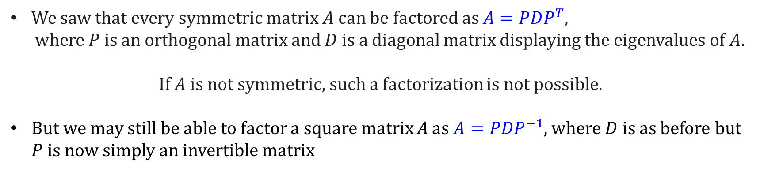
Singular Value Decomposition
We saw that every symmetric matrix $A$ can be factored as $A=PDP^{T}$,
where$P$is an orthogonal matrix and $D$is a diagonal matrix displaying the eigenvalues of $A$.
If $A$ is not symmetric, such a factorization is not possible.
But we may still be able to factor a square matrix A as $A=PDP^{−1}$, where $D$ is as before but $P$ is now simply an invertible matrix
However, not every matrix is diagonalizable, so it may surprise you that we will now show that every matrix (symmetric or not, square or not) has a factorization of the form $A=PDQ^{T},$where
$P$ and $Q$ are orthogonal and $D$ is a diagonal matrix!
This remarkable result is the singular value decomposition (SVD), and it is one of the most important of all matrix factorizations.

Slide 91

Singular Value Decomposition
$A=PDQ^{T},$where $P$ and $Q$ are orthogonal and $D$ is a diagonal matrix!
Note 1: Eigenvalues of $A^{T}A$are real

Slide 92
Singular Value Decomposition
$A=PDQ^{T},$where $P$ and $Q$ are orthogonal and $D$ is a diagonal matrix!

Slide 93

Singular Value Decomposition
$A=PDQ^{T},$where $P$ and $Q$ are orthogonal and $D$ is a diagonal matrix!
Note 1: Eigenvalues of $A^{T}A$are real
Note 2: Eigenvectors ($v_{i}$) of $A^{T}A$ form orthogonal/normal basis
Note 3: $Norm of Av_{i}$ is the i th singular value of $A$

Slide 94
Singular Value Decomposition
$A=PDQ^{T},$where $P$ and $Q$ are orthogonal and $D$ is a diagonal matrix!

Slide 95
Singular Value Decomposition
$A=PDQ^{T},$where $P$ and $Q$ are orthogonal and $D$ is a diagonal matrix!

Slide 96

Singular Value Decomposition
$A=PDQ^{T},$where $P$ and $Q$ are orthogonal and $D$ is a diagonal matrix!
Note 1: Eigenvalues of $A^{T}A$are real.
Note 2: Eigenvectors ($v_{i}$) of $A^{T}A$ form orthogonal basis.
Note 3: $Norm of Av_{i}$ is the singular value of $A.$
Note 4: $\{Av_{i}$} also forms orthogonal set $i=1,…,n$

Slide 97

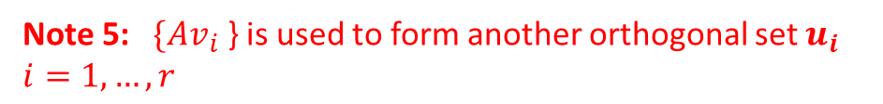
Singular Value Decomposition
$A=PDQ^{T},$where $P$ and $Q$ are orthogonal and $D$ is a diagonal matrix!
Note 1: Eigenvalues of $A^{T}A$are real.
Note 2: Eigenvectors ($v_{i}$) of $A^{T}A$ form orthogonal basis.
Note 3: $Norm of Av_{i}$ is the singular value of $A.$
Note 4: $\{Av_{i}$} also forms orthogonal set $i=1,…,n$
Note 5: $\{Av_{i}$} is used to form another orthogonal set $u_{i}$ $i=1,…,r$

Slide 98
Singular Value Decomposition
$A=PDQ^{T},$where $P$ and $Q$ are orthogonal and $D$ is a diagonal matrix!

Slide 99
Singular Value Decomposition

Slide 100
Singular Value Decomposition

Slide 104
Singular Value Decomposition
Application(norm calculation)

Slide 105



